Slide 1
Should College Athletes be Paid?
By: Austin Humphrey

Slide 2
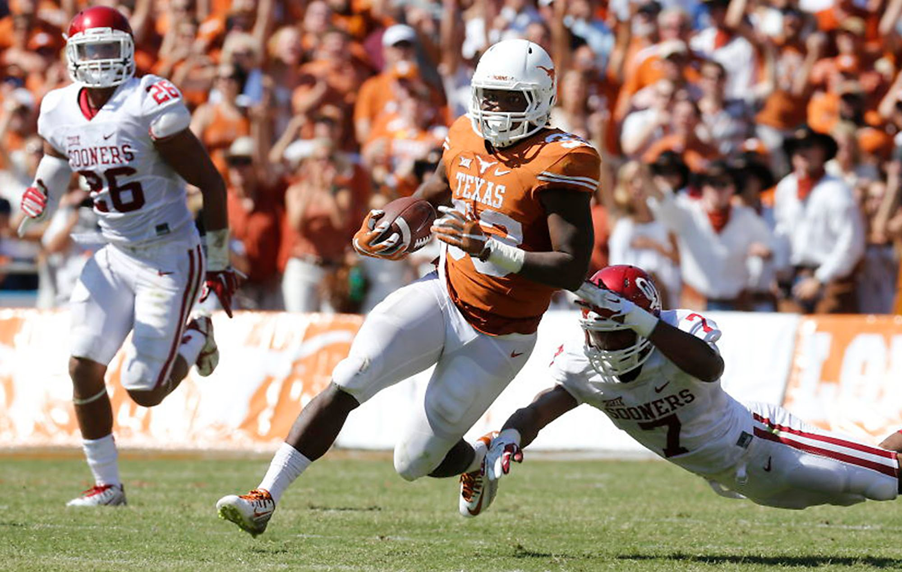
Overview
The Counter-Argument:
Why should players be paid?
Main Argument:
Breaking down revenue by sport
Scholarships and other benefits for student-athletes

Slide 3
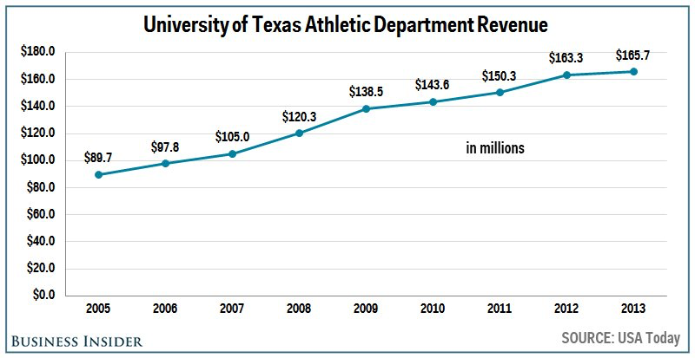
Counter: Why College Athletes Should Be Paid
Athletic departments generate millions a year for universities
Trending up for most schools
Student-athletes claim scholarship benefits are barely sufficient
Cost of coaches
Jim Harbaugh’s $9+ million contract (USA Today)
Extravagant stadiums costs

Slide 4
Breaking Down Revenue By Sport
Men’s basketball/football are only consistent revenue generators
At University of Florida combined for roughly $46.5 million in revenue (Forbes, 2012)
All other sports combined lost UF $12.3 million (Forbes, 2012)
Many departments fail to break even
Only 24 FBS schools had positive surplus (NCAA, 2014)
Leaves the university to subsidize failing programs
If positive earnings (if positive) only produced by two sports, why should all athletes be paid?

Slide 5
Reasons Why Current Benefits Suffice
Scholarships include food, medical care, tuition, tutoring, and the NCAA Student Assistant Fund
Full men’s basketball scholarship worth up to $120,000/year (NCAA)
No post-grad debt
Average college student graduates with $35,200 in debt (NCAA)
Lack of education in budgeting money
Roughly 78% of NFL players bankrupt 3 years after retirement (Sports Illustrated, 2009)
They’re college students, not professionals
Considering current compensation coupled with college students/athletes track record with budgeting, why a salary?

Slide 6
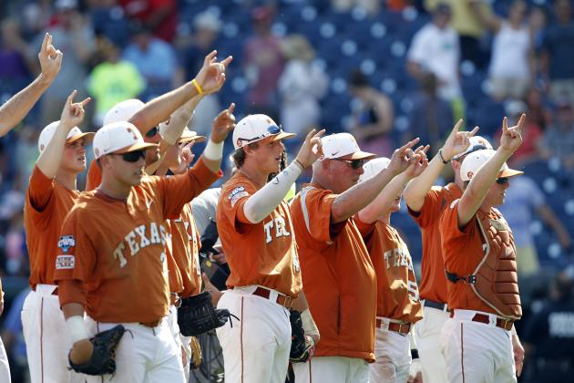
Conclusion
Recap:
Large distribution in positive earnings between sports
Various non-monetary benefits
Now next time you’re watching the Horns kick OU up and down the field, you’ll have a background on how these athletes get by off it!

Slide 7
Reference Page
Dosh, K. (2012, July 30). Does Football Fund Other Sports At College Level? Retrieved April 08, 2017, from https://www.forbes.com/sites/sportsmoney/2011/05/05/des-football-fund-other-sports-at-college-level/#50933b0371c2.
Watkins, M. (2016, March 17). Protecting the Weak Side: College Football Revenue Props Up Other Sports. Retrieved April 08, 2017, from https://www.texastribune.org/2016/03/17/how-college-football-props-entire-athletic-departm/.
Steinberg, L. (2015, February 09). 5 Reasons Why 80% Of Retired NFL Players Go Broke. Retrieved April 08, 2017, from https://www.forbes.com/sites/leighsteinberg/2015/02/09/5-reasons-why-80-of-retired-nfl-players-go-broke/#7f691d5b78cc.
TORRE, P. S. (2009, March 23). How (and Why) Athletes Go Broke. Retrieved April 08, 2017, from https://www.si.com/vault/2009/03/23/105789480/how-and-why-athletes-go-broke#.
D. (2014, January 03). Benefits to College Student-Athletes. Retrieved April 10, 2017, from http://www.ncaa.org/student-athletes/benefits-college-student-athletes.
USA TODAY Sports. (n.d.). Retrieved April 10, 2017, from http://sports.usatoday.com/ncaa/salaries/.
S. (2015, September 18). Athletics departments that make more than they spend still a minority. Retrieved April 10, 2017, from http://www.ncaa.org/about/resources/media-center/news/athletics-departments-make-more-they-spend-still-minority.

